Slide 1



Name of the School: School of Computer Science and Engineering
Course Code: E2UC102C Course Name: PROGRAMMING FOR PROBLEM-SOLVING
Hospital Management System
With Python
Uday Dixit and Jagriti Rai
B.Tech-CSE(Section 52)
Email id:duday688@gmail.com
Programe Name: B.Tech (CSE)

Slide 2
Name of the School: School of Computer Science and Engineering
Course Code: E2UC102C Course Name: PROGRAMMING FOR PROBLEM-SOLVING
Introduction
Purpose
To perform automation of Hospital Management
The Software includes:-
Maintaining, Searching, Editing Patient Details
Maintaining, Searching, Editing Doctor Details
Providing Prescription
Appointment booking
Programe Name: B.Tech (CSE)

Slide 3
Name of the School: School of Computer Science and Engineering
Course Code: E2UC102C Course Name: PROGRAMMING FOR PROBLEM-SOLVING
Problem Description
Lack of immediate retrievals
Lack of immediate information storage
Lack of prompt updating
Error prone manual calculation
Preparation of accurate and prompt reports
Programe Name: B.Tech (CSE)

Slide 4
Name of the School: School of Computer Science and Engineering
Course Code: E2UC102C Course Name: PROGRAMMING FOR PROBLEM-SOLVING
Objectives
Streamline patient and doctor data management.
Improve the assignment of doctors to patients.
Enhance the overall efficiency of hospital administration.
Programe Name: B.Tech (CSE)

Slide 5
Name of the School: School of Computer Science and Engineering
Course Code: E2UC102C Course Name: PROGRAMMING FOR PROBLEM-SOLVING
Methodology
To create this effective software for the managing of hospital data related to patients, doctors, and appointment management, We mostly used Python programming.
We used MS Excel along with python for the smooth data manipulation according to need.
Programe Name: B.Tech (CSE)

Slide 6
Name of the School: School of Computer Science and Engineering
Course Code: E2UC102C Course Name: PROGRAMMING FOR PROBLEM-SOLVING
Methodology
3. The software runs on python console itself and uses excel for the sole purpose of storing data
Programe Name: B.Tech (CSE)

Slide 7
Start
|
v
[Initialize variables]
|
v
[Welcome message]
|
v
[Set up a loop for user interaction]
|
v
|--[Read patient and doctor data from Excel]
|
|--[Display menu for Admin or User mode]
| |
| |--[Admin mode]
| | |
| | |--[Authenticate with password]
| | |
| | |--[Display admin options]
| | | |
| | | |--[Patients Management]
| | | | |
| | | | |--[Add, Display, Delete, Edit patients]
| | | |
| | | |--[Doctors Management]
| | | | |
| | | | |--[Add, Display, Delete, Edit doctors]
| | | |
| | | |--[Appointment Management]
| | | |
| | | |--[Book, Edit, Cancel appointments]
| | |
| | |--[Write updated data to Excel]
| |
| |--[User mode]
| |
| |--[Display user options]
| | |
| | |--[View hospital departments, doctors, patients]
| | |
| | |--[View patient details, doctor appointments]
| | |
| | |--[Back]
| |
| |--[Exit user mode]
|
|--[Handle incorrect choices, passwords, and other conditions]
|
v
[Continue the loop or end the program]
|
v
End
Name of the School: School of Computer Science and Engineering
Course Code: E2UC102C Course Name: PROGRAMMING FOR PROBLEM-SOLVING
Flowchart
Programe Name: B.Tech (CSE)

Slide 8
Name of the School: School of Computer Science and Engineering
Course Code: E2UC102C Course Name: PROGRAMMING FOR PROBLEM-SOLVING
Algorithm
1. Initialization:
Import necessary modules (Read_Hospital_Excel_Sheet and Write_Hospital_Excel_Sheet).
Define the function AppointmentIndexInDoctorsDataBase(patient_ID) to find the index of a patient's appointment in the doctor's database.
Welcome Message:
Print a welcome message for the hospital management system.
3. Read Data:
Read patient and doctor data from Excel using the functions from the imported modules.
4. Display Menu:
Display the menu for Admin or User mode.
Get the user's mode choice (Admin_user_mode).
Programe Name: B.Tech (CSE)

Slide 9
Name of the School: School of Computer Science and Engineering
Course Code: E2UC102C Course Name: PROGRAMMING FOR PROBLEM-SOLVING
Algorithm
5. Admin Mode:
Check if the user chose Admin mode (if Admin_user_mode == "1").
Authenticate with a password (Password).
Enter a loop for Admin options.
5.1. Manage Patients:
Display options for patient management.
Based on the user's choice, perform actions like adding, displaying, deleting, or editing patient data.
5.2. Manage Doctors:
Display options for doctor management.
Based on the user's choice, perform actions like adding, displaying, deleting, or editing doctor data.
5.3. Manage Appointments:
Display options for appointment management.
Based on the user's choice, perform actions like booking, editing, or canceling appointments.
5.4. Write Data to Excel:
Save the updated patient and doctor data back to Excel.
5.5. Exit Admin Mode:
Break out of the Admin options loop.
Programe Name: B.Tech (CSE)

Slide 10
Name of the School: School of Computer Science and Engineering
Course Code: E2UC102C Course Name: PROGRAMMING FOR PROBLEM-SOLVING
Algorithm
6. User Mode:
Check if the user chose User mode (elif Admin_user_mode == "2").
Enter a loop for User options.
6.1. View Hospital Information:
Display options to view hospital departments, doctors, patients, etc.
Based on the user's choice, provide relevant information.
6.2. Exit User Mode:
Break out of the User options loop.
7. Handling Incorrect Choices:
Display error messages for incorrect choices, passwords, or other conditions.
8. Continue or End:
Continue the main loop for further interactions or end the program.
Programe Name: B.Tech (CSE)

Slide 11
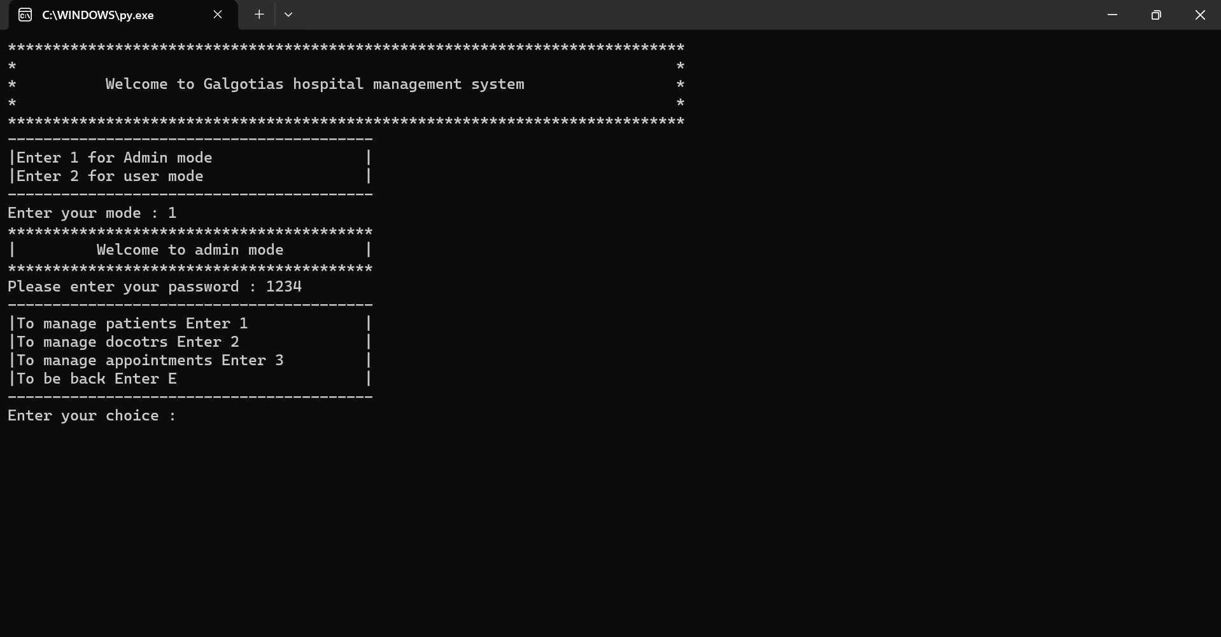
Name of the School: School of Computer Science and Engineering
Course Code: E2UC102C Course Name: PROGRAMMING FOR PROBLEM-SOLVING
Result(Screenshots from the program)
Programe Name: B.Tech (CSE)

Slide 12
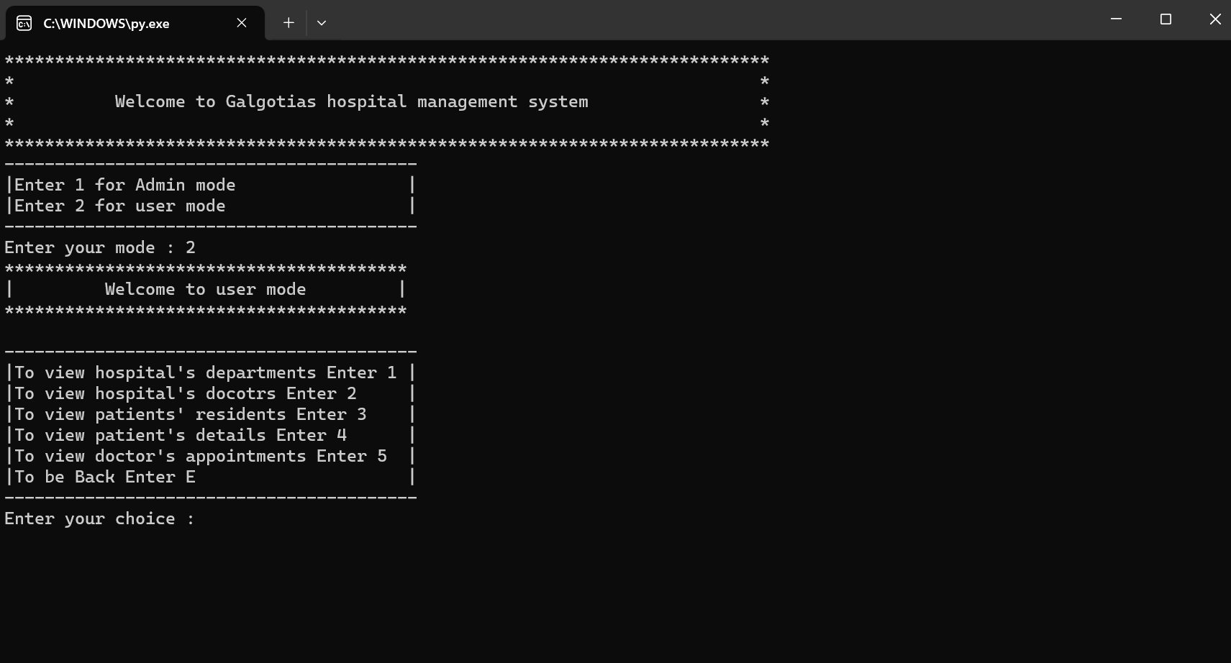
Name of the School: School of Computer Science and Engineering
Course Code: E2UC102C Course Name: PROGRAMMING FOR PROBLEM-SOLVING
Result(Screenshots from the program)
Programe Name: B.Tech (CSE)

Slide 13
Name of the School: School of Computer Science and Engineering
Course Code: E2UC102C Course Name: PROGRAMMING FOR PROBLEM-SOLVING
Advantages of computerized hospital management system:
Immediate Access of data
Time saving
Data can be easily insert/update/delete
Saving paper work
Give facility of different types of Enquiry
Programe Name: B.Tech (CSE)

Slide 14

Name of the School: School of Computer Science and Engineering
Course Code: E2UC102C Course Name: PROGRAMMING FOR PROBLEM-SOLVING
Scope of this project:
Can be used in any Hospital, Clinic, Dispensary or Pathology labs for maintaining patient details and their test results.
Programe Name: B.Tech (CSE)

Slide 15
Name of the School: School of Computer Science and Engineering
Course Code: E2UC102C Course Name: PROGRAMMING FOR PROBLEM-SOLVING
Conclusion:
In this ppt, we discussed that manual handling of hospital data is very inefficient because it takes up too much time and the chances for errors are huge.
To deal with this specific problem we designed a simple python software that makes this work a lot easier with minimal efforts.
Programe Name: B.Tech (CSE)

Slide 16
Name of the School: School of Computer Science and Engineering
Course Code: E2UC102C Course Name: PROGRAMMING FOR PROBLEM-SOLVING
THANK YOU
Programe Name: B.Tech (CSE)

